Slide 1

Employee Management System
Prepared By ,
Sayeed Saadman Saad ( ID : C231112 )
Walid ( ID : C231111 )
Abdul Latif Sayam ( ID : C231104 )

Slide 2

Introduction
The Employee Management System (EMS) is a console-based application developed in C++ to streamline the management of employee information.
This system allows administrators to efficiently perform various operations such as adding, editing, deleting, searching employee records and also print employee salary slip.
The EMS also includes user authentication to ensure secure access to the system.

Slide 3
Project Overview
User-Friendly Admin Panel : The system features an intuitive admin panel with three primary options: Register, Login, and Exit.
Secure Registration and Login : The registration process involves creating a username and password, which are stored in a secure file. The login functionality verifies the against the registered data, ensuring authorized access to the control menu.
Comprehensive Control Menu : The control menu offers eight essential functions: * Add Employee * Update Employee * Delete Employee * Search Employee * Display All Employees * Salary Slip Generator * Go to Admin Panel * Exit
Employee Data Management : The system enables efficient management of employee data, including adding, updating, and deleting employee records, as well as searching and displaying employee information.
Salary Slip Generation : The system features a built-in salary slip generator, allowing administrators to easily generate salary slips for employees, streamlining payroll processes.

Slide 4
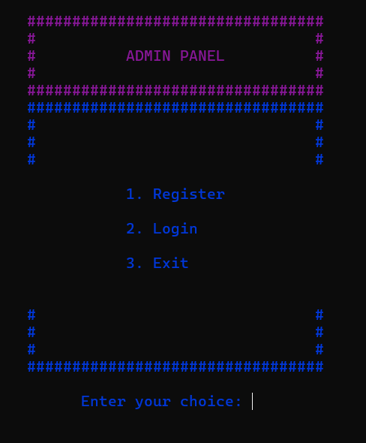
Admin Panel Functionality
Register : Create a new admin account with a username and password and stored it in a secured file.
Login : Verify with the secured file and access to the control menu
Exit : Terminate the console.

Slide 5
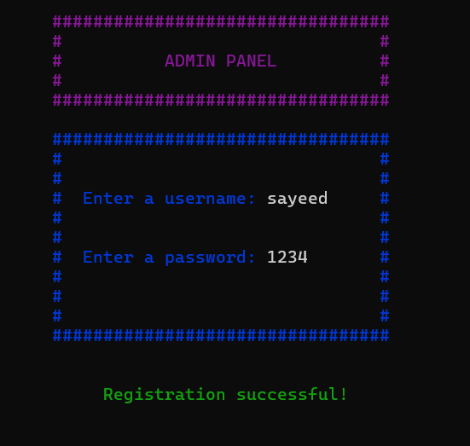
Register Functionality
Create a new admin account by entering a unique username and password.
Store the registered information securely in the file.

Slide 6
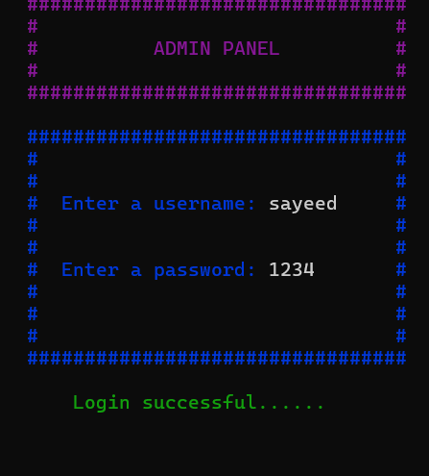
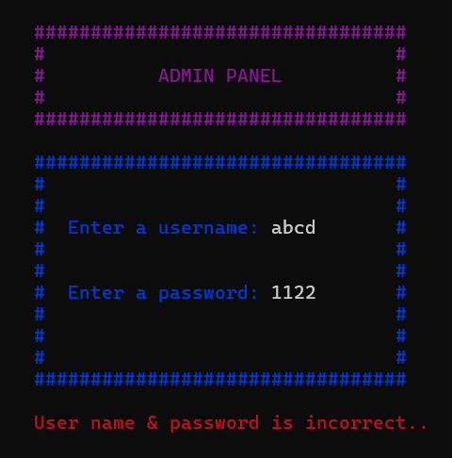
Login Functionality
Enter a username and password to attempt login
Verify the entered information against the stored data in secure file.
Grant access to the control menu if the information match , otherwise display an error message.

Slide 7
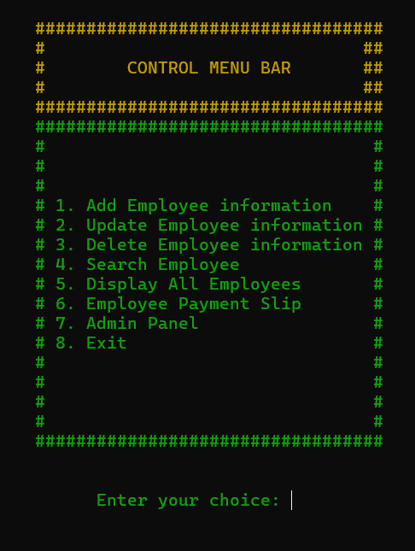
Control Menu Overview
List of options available in the control Menu
1. Add Employee
2. Update Employee
3. Delete Employee
4. Search Employee
5. Display all Emloyees
6. Salary Slip Genarator
7. Go to Admin Panel
8. Exit

Slide 8
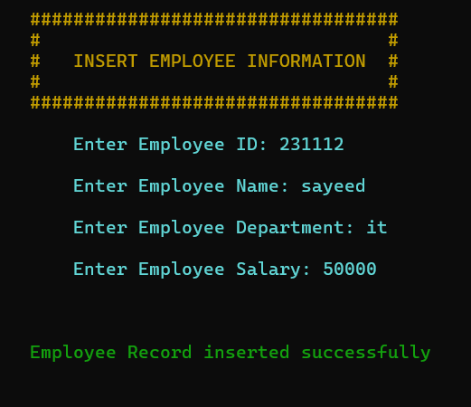
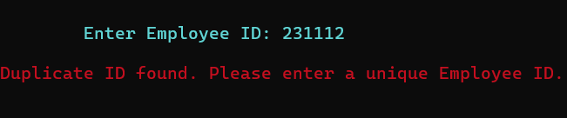
Add Employee Functionality
Enter employee details as id, name , department, salary.
Store the new employee’s information in the file for future reference.
Also check if any id is duplicate or not using the previous saved file. If it found duplicates then it will return that input a unique id.

Slide 9
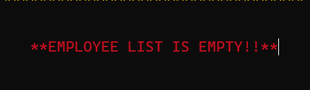
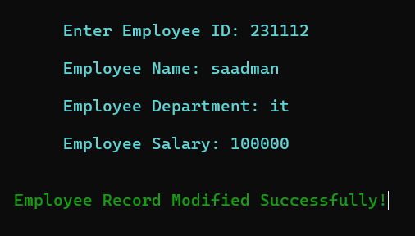
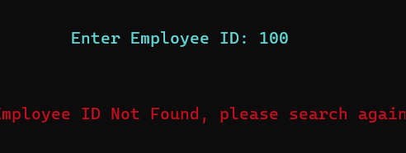
Update Employee Functionality
Search for an existing employee by Id .
If the employee list is empty is will return Employee list is empty!.
Allow the Admin to modify the Employee informations.
Overwrite the existing employee data in the file with the updated information.
If the searching id not present in the file it will return to Search again id.

Slide 10
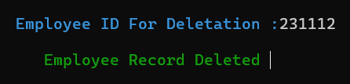

Delete Employee Functionality
Search for an existing employee by Id and confirm deletion process.
Remove the employee information from the employee file also.
Update the employee database and delete the information.

Slide 11
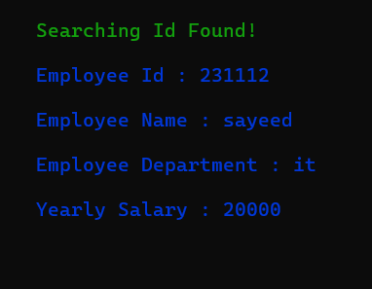
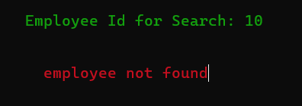
Search Employee Functionality
Allow the admin to input an employee id to search for.
Retrieve and display the corresponding employee’s information from the employee file.
Handle cases where employee not found, displaying an appropriate error message.

Slide 12
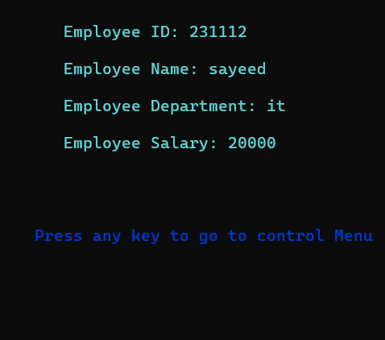
Display all Employee Functionality
Display all employee information from the secure file.
Organize and format the displayed data in a clear and readable manner.

Slide 13
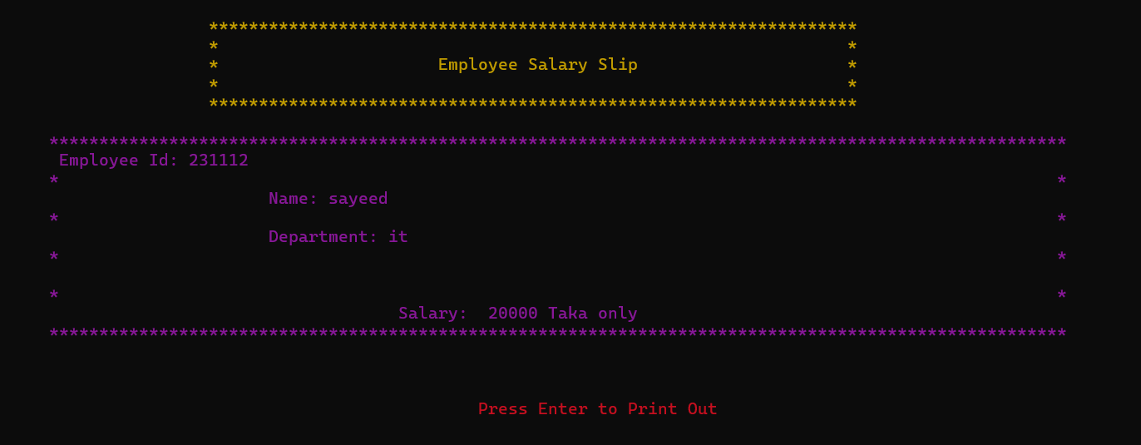
Salary Slip Functionality
Search for an existing employee by Id and confirm Payment Slip process.
Generate a salary slip with the employee's details.

Slide 14
Conclusion
The Employee Management System (EMS) is a robust and efficient tool for managing employee information within an organization. By providing functionalities such as user authentication, adding and editing employee records, searching, and generating salary slips, the EMS streamlines administrative tasks and enhances productivity.
In conclusion, the EMS represents a significant step towards efficient employee management. With continued development and the integration of advanced features, it has the potential to become an indispensable tool for organizations of all sizes.

